Slide 1
Become a photographer
Banner (1219x178)
Take pictures
Home
About us
Contact
Apps
5 tips that will help you take better tips
Date
1. Camera grid
2. Focus
Image showing camera grid (400x200)
Image showing how focus works(360x200)
Information about Camera Grid
Information about Focus
3. Filters
4. “Find light. No flash”
Image Showing different types of filters(400x200)
Image showing an example of how to use lightning in a picture (360x200)
Information about Filters
Information about Camera
5. HDR
Image showing how hdr works( 400x200)

Slide 2
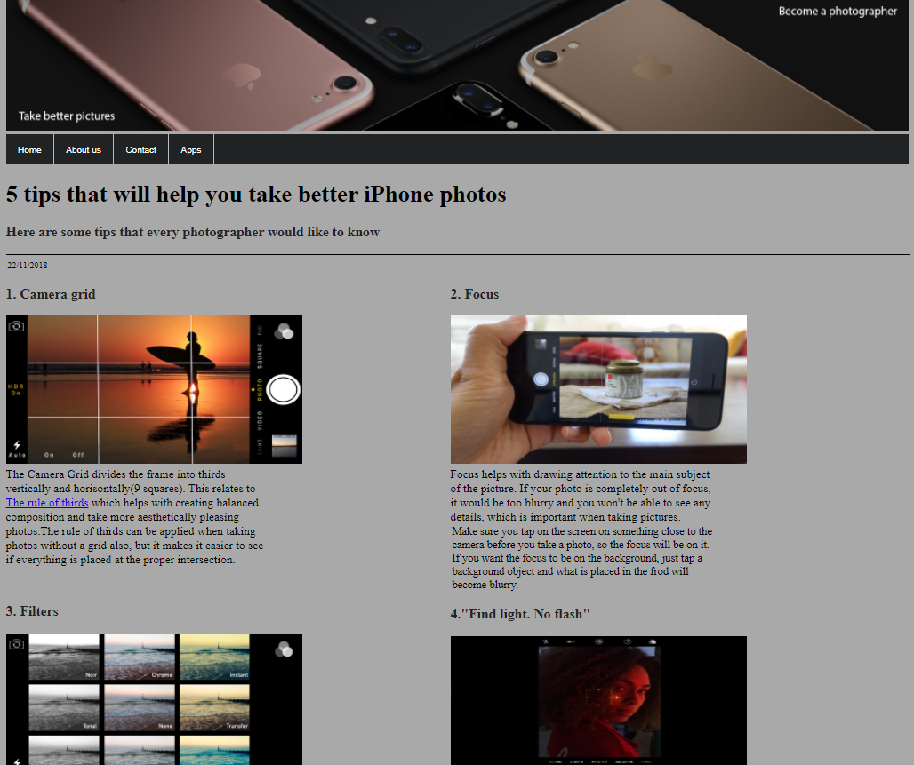

Slide 3
Become a photographer
Banner (1219x178)
Take pictures
Home
About us
Contact
Apps
Image which contains information about my website (1219x178)

Slide 4
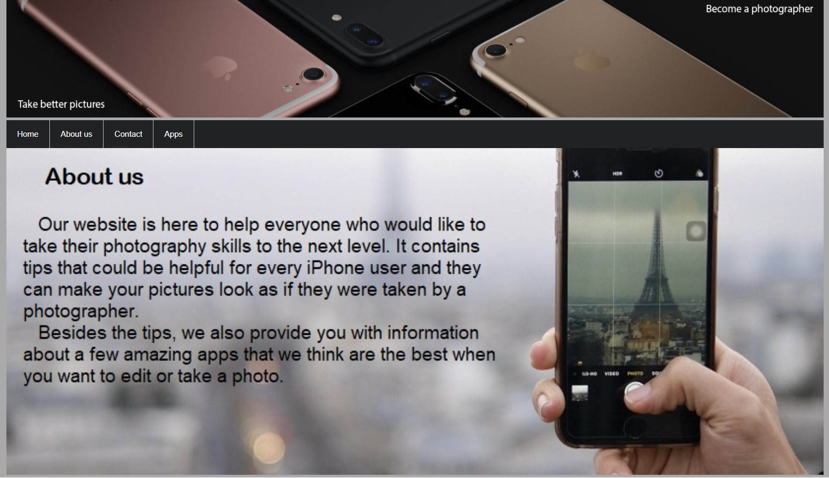

Slide 5
Become a photographer
Banner (1219x178)
Banner (1219x178)
Take pictures
Take pictures
Home
About us
Contact
Apps
Welcome …
Contact us
Title
Heading
Surname
Paragraph 1
First Name
Paragraph 2
Email
message
Mail logo
(21x21)
Paragraph 3
Phone logo
(20x20)
Paragraph 4
Reset
Paragraph 5
Submit
Facebook logo
(20x20)
Instagram logo
(21x21)
Twitter logo
(25x20)

Slide 6
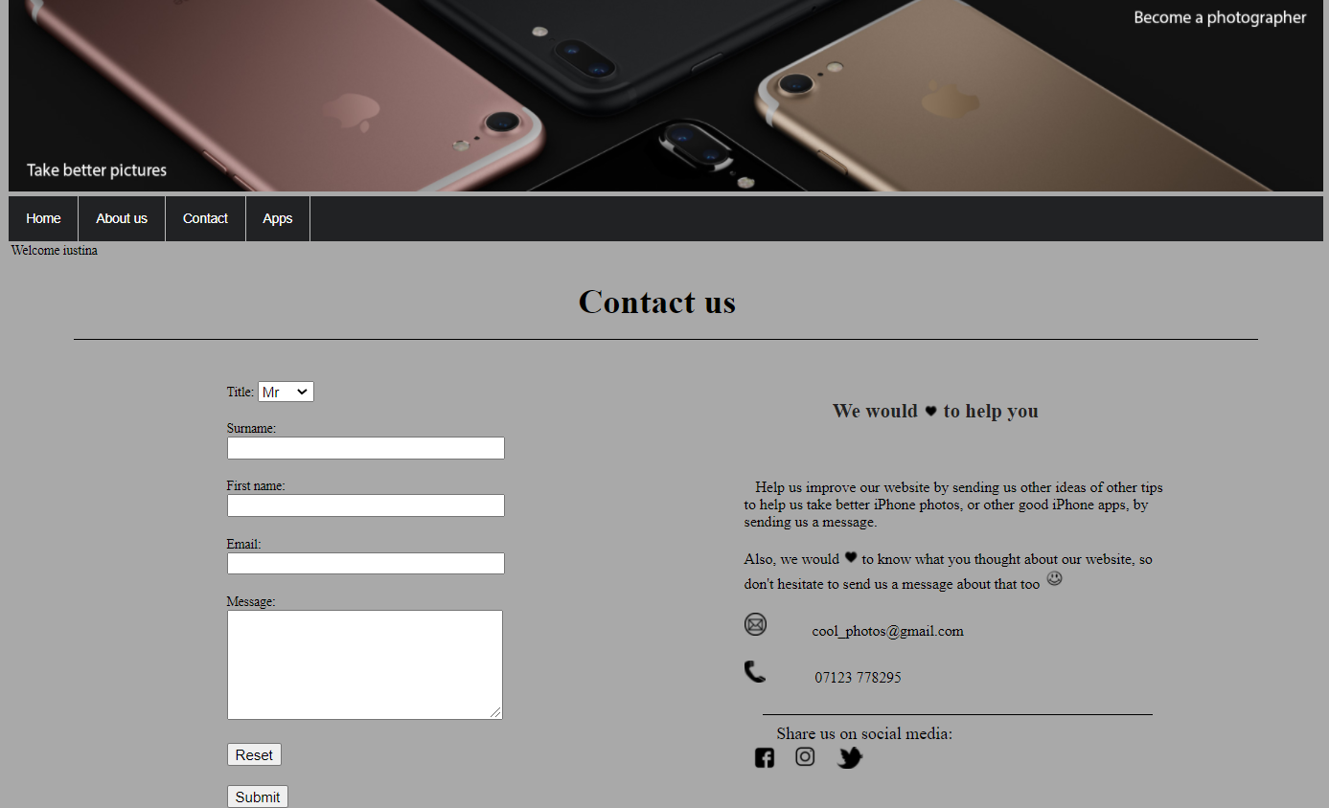

Slide 7
Become a photographer
Banner (1219x178)
Take pictures
Home
About us
Contact
Apps
The best photo apps to help you take great pictures
1. 8mm Vintage Camera
Paragraph1- Information about Vintage Camera
Video showing how to use this app (560x315)
2. Snapseed
Paragraph1- Information about Snapseed
Video (560x315)
3. VSCO
Paragraph1- Information about VSCO
Image showing how VSCO works (560x315)

Slide 8
